Slide 1
Inverse DAS Cable using Least-squares
Thein Lin Aung
Feb 20, 2023

Slide 2
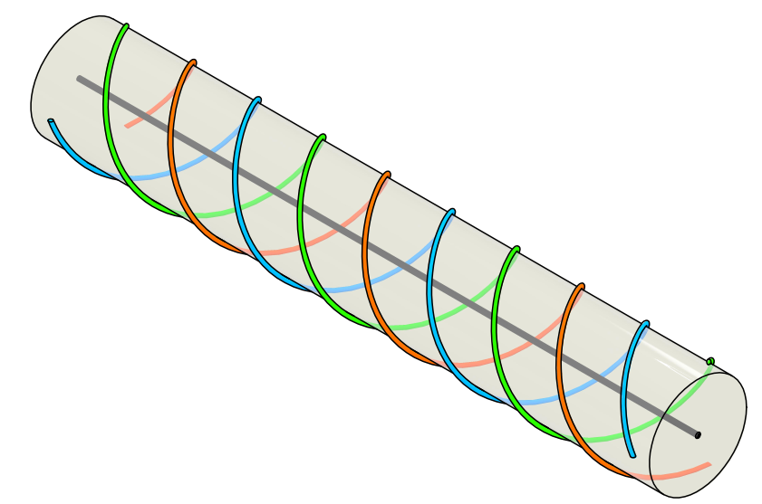
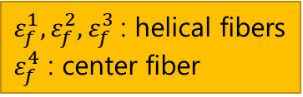
Cable Overview
4 fibers (3 helical + 1 axial)
Gauge length* = 0.1 m ~ 2 m
Forces: axial strain, pressure, bending
*moving average window
$ε_{f}^{1}, ε_{f}^{2},ε_{f}^{3}$ : helical fibers
$ε_{f}^{4}$ : center fiber

Slide 3
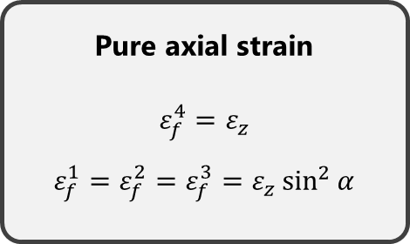
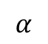
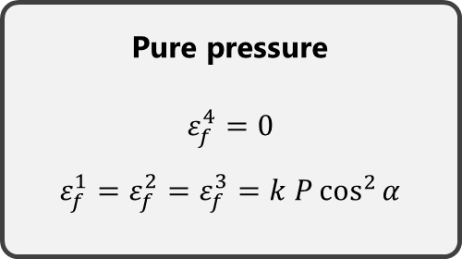
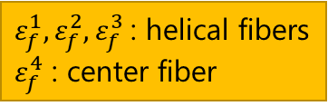
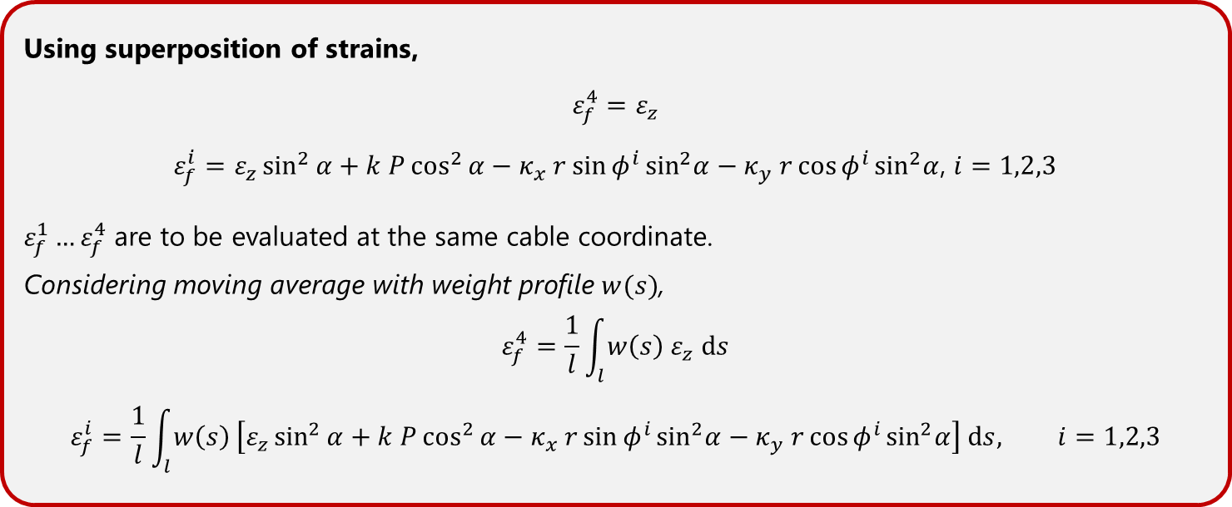
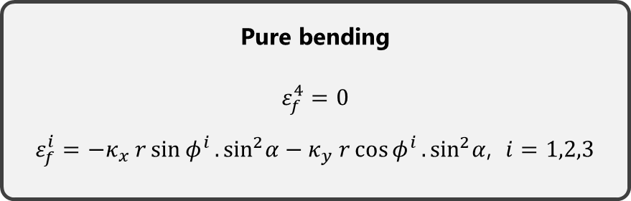
Axial strain + Pressure + Bending
$ε_{f}^{1}, ε_{f}^{2},ε_{f}^{3}$ : helical fibers
$ε_{f}^{4}$ : center fiber
Pure axial strain
$$ε_{f}^{4}=ε_{z}$$
$$ε_{f}^{1}=ε_{f}^{2}=ε_{f}^{3}=ε_{z}\sin^{2}{α}$$
Pure pressure
$$ε_{f}^{4}=0$$
$$ε_{f}^{1}=ε_{f}^{2}=ε_{f}^{3}=k P\cos^{2}{α}$$
Pure bending
$$ε_{f}^{4}=0$$
$ε_{f}^{i}=−κ_{x} r\sin{φ^{i}}.\sin^{2}α−κ_{y} r\cos{φ^{i}}.\sin^{2}α$, $i=1,2,3$
Using superposition of strains,
$$ε_{f}^{4}=ε_{z}$$
$ε_{f}^{i}=ε_{z}\sin^{2}{α}+k P\cos^{2}{α}−κ_{x} r\sin{φ^{i}}\sin^{2}α−κ_{y} r\cos{φ^{i}}\sin^{2}α$, $i=1,2,3$
$ε_{f}^{1}…ε_{f}^{4}$ are to be evaluated at the same cable coordinate.
Considering moving average with weight profile $w(s)$,
$$ε_{f}^{4}=\frac{1}{l}\int_{l}{w\left(s\right) ε_{z} ds}$$
$$ε_{f}^{i}=\frac{1}{l}\int_{l}{w\left(s\right)}\left[ε_{z}\sin^{2}{α}+k P\cos^{2}{α}−κ_{x} r\sin{φ^{i}}\sin^{2}α−κ_{y} r\cos{φ^{i}}\sin^{2}α\right] ds, i=1,2,3$$
$$α$$

Slide 4
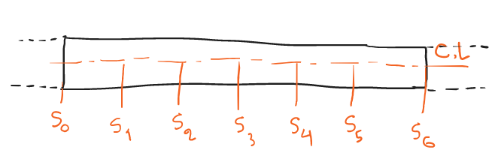
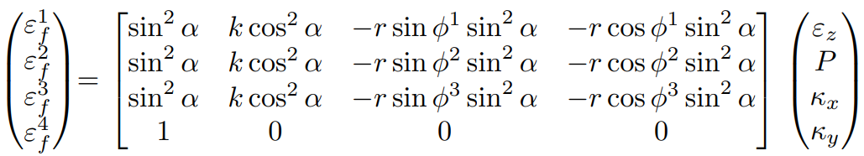
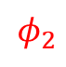

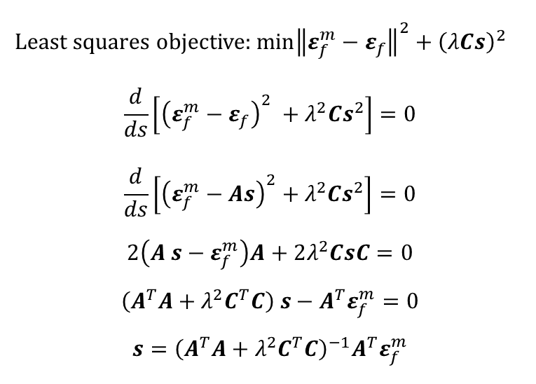
Transfer function
Transfer function (point strain)
Evaluated at a single cross section, no averaging
Regularized Least-squares
Evaluated for a certain length of the cable
Least squares objective:$\min{{\left\|ε_{f}^{m}−ε_{f}\right\|}^{2}+{\left(λCs\right)}^{2}}$
$$\frac{d}{ds}\left[{\left(ε_{f}^{m}−ε_{f}\right)}^{2} +λ^{2}Cs^{2}\right]=0$$
$$\frac{d}{ds}\left[{\left(ε_{f}^{m}−As\right)}^{2}+λ^{2}Cs^{2}\right]=0$$
$$2\left(A s−ε_{f}^{m}\right)A+2λ^{2}CsC=0$$
$$\left(A^{T}A+λ^{2}C^{T}C\right) s−A^{T}ε_{f}^{m}=0$$
$$s={\left(A^{T}A+λ^{2}C^{T}C\right)}^{−1}A^{T}ε_{f}^{m}$$
$$φ_{1}$$
Cross section
$$φ_{2}$$
All fiber strains (least-squares)

Slide 5
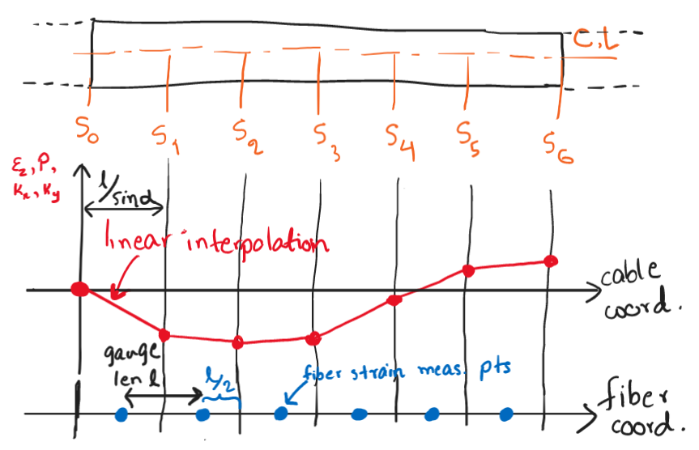
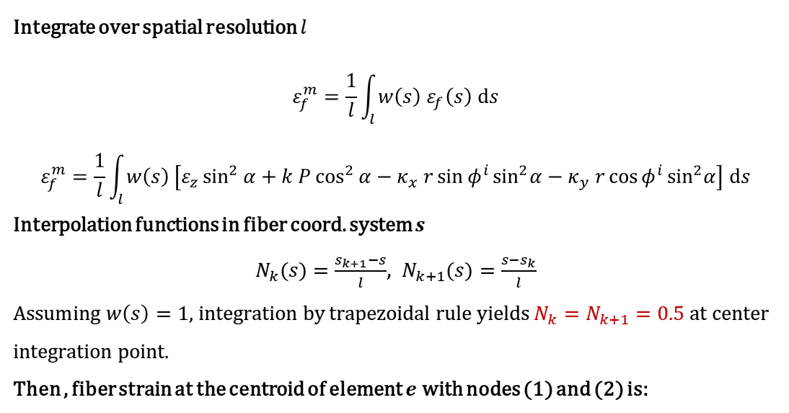
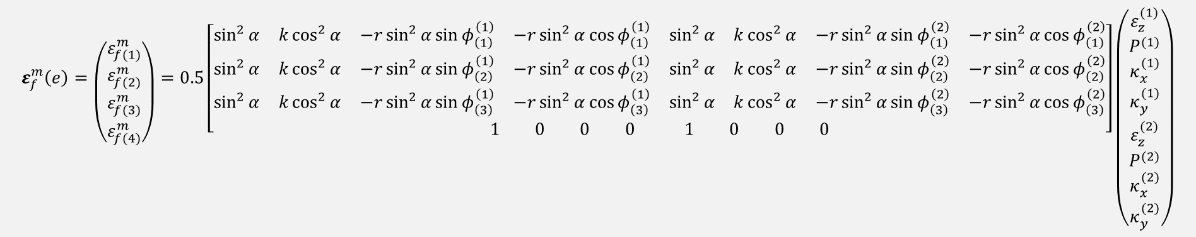

Least-squares Formulation
Cable length (L) is discretized into nodes.
Nodal variables are interpolated using a linear function
Integrate over spatial resolution $l$
$$ε_{f}^{m}=\frac{1}{l}\int_{l}{w\left(s\right) ε_{f}\left(s\right) ds}$$
$$ε_{f}^{m}=\frac{1}{l}\int_{l}{w\left(s\right)}\left[ε_{z}\sin^{2}{α}+k P\cos^{2}{α}−κ_{x} r\sin{φ^{i}}\sin^{2}α−κ_{y} r\cos{φ^{i}}\sin^{2}α\right] ds$$
Interpolation functions in fiber coord. system $s$
$N_{k}(s)=\frac{s_{k+1}−s}{l}$, $N_{k+1}(s)=\frac{s−s_{k}}{l}$
A$ssuming w\left(s\right)=1$, integration by trapezoidal rule yields $N_{k}=N_{k+1}=0.5$ at center integration point.
Then , fiber strain at the centroid of element $e$ with nodes (1) and (2) is:
$ε_{z},P,κ_{x},κ_{y},φ^{i}$ are functions of $s$
$$ε_{f}^{m}\left(e\right)=\left({ε_{f(1)}^{m} \atop \begin{aligned}ε_{f(2)}^{m} \\ ε_{f(3)}^{m} \\ ε_{f(4)}^{m}\end{aligned}}\right)=0.5\left[\begin{aligned}\begin{matrix}\sin^{2}{α} & k\cos^{2}{α} & −r\sin^{2}{α}sin{φ_{\left(1\right)}^{\left(1\right)}} & −r\sin^{2}{α}cos{φ_{\left(1\right)}^{\left(1\right)}} & \begin{matrix}\sin^{2}{α} & k\cos^{2}{α} & −r\sin^{2}{α}sin{φ_{\left(1\right)}^{\left(2\right)}} & −r\sin^{2}{α}cos{φ_{\left(1\right)}^{\left(2\right)}}\end{matrix}\end{matrix} \\ \begin{matrix}\sin^{2}{α} & k\cos^{2}{α} & −r\sin^{2}{α}sin{φ_{\left(2\right)}^{\left(1\right)}} & −r\sin^{2}{α}cos{φ_{\left(2\right)}^{\left(1\right)}} & \begin{matrix}\sin^{2}{α} & k\cos^{2}{α} & −r\sin^{2}{α}sin{φ_{\left(2\right)}^{\left(2\right)}} & −r\sin^{2}{α}cos{φ_{\left(2\right)}^{\left(2\right)}}\end{matrix}\end{matrix} \\ \begin{matrix}\sin^{2}{α} & k\cos^{2}{α} & −r\sin^{2}{α}sin{φ_{\left(3\right)}^{\left(1\right)}} & −r\sin^{2}{α}cos{φ_{\left(3\right)}^{\left(1\right)}} & \begin{matrix}\sin^{2}{α} & k\cos^{2}{α} & −r\sin^{2}{α}sin{φ_{\left(3\right)}^{\left(2\right)}} & −r\sin^{2}{α}cos{φ_{\left(3\right)}^{\left(2\right)}}\end{matrix}\end{matrix} \\ \begin{matrix}1 & 0 & 0 & 0\end{matrix} \begin{matrix}1 & 0 & 0 & 0\end{matrix}\end{aligned}\right]\left({ε_{z}^{(1)} \atop \begin{aligned}P^{(1)} \\ κ_{x}^{(1)} \\ κ_{y}^{(1)} \\ ε_{z}^{(2)} \\ P^{(2)} \\ κ_{x}^{(2)} \\ κ_{y}^{(2)}\end{aligned}}\right)$$
Subscript (n) refers to fiber number and superscript (n) refers to node number.
For center fiber (4), measurements are not located at the element centroids. Use interpolated fiber strains to simplify the formulation.

Slide 6
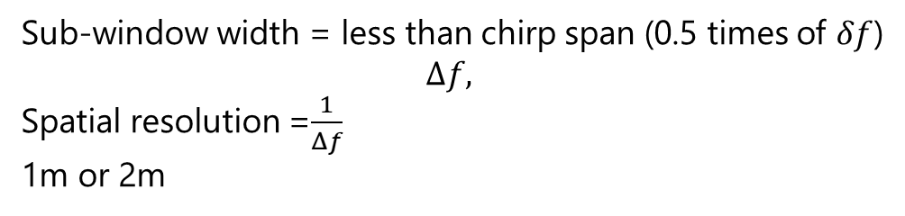
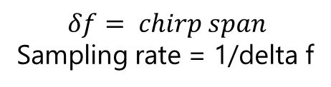
Gauge length and SR in chirp
$$δf= chirp span$$
Sampling rate = 1/delta f
Gauge length , 0.2m
Decode length
Sub-window width = less than chirp span (0.5 times of $δf$)
$$Δf,$$
Spatial resolution =$\frac{1}{Δf}$
1m or 2m

Slide 7
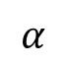
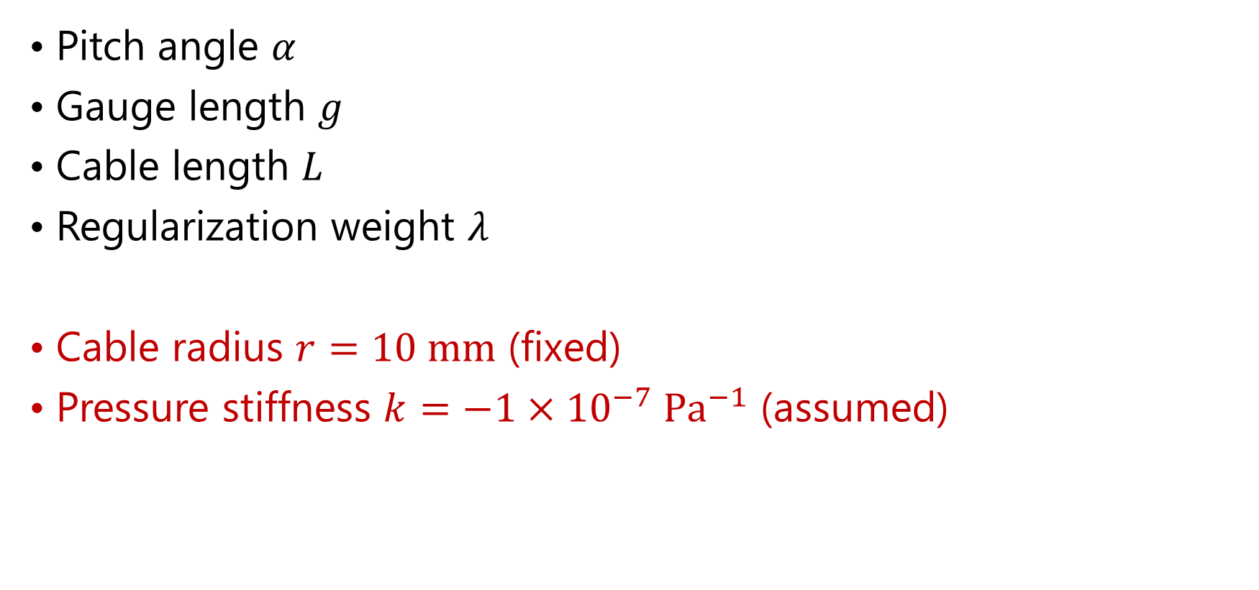
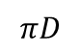
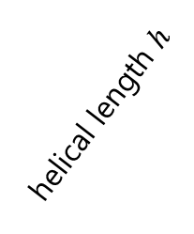
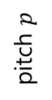
Parameters for Numerical Testing
Pitch angle $α$
Gauge length $g$
Cable length $L$
Regularization weight $λ$
Cable radius $r=10 mm$ (fixed)
Pressure stiffness $k=−1×{10}^{−7} Pa^{−1}$ (assumed)
helical length $h$
pitch $p$
$$α$$
$$πD$$
$$α$$

Slide 8
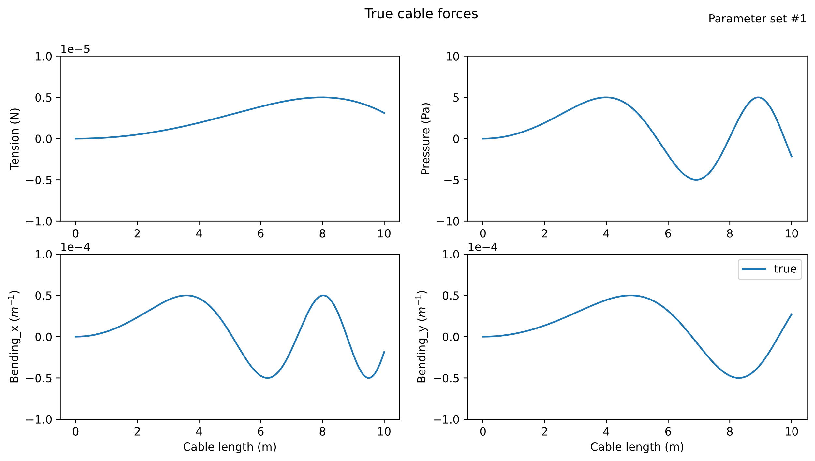
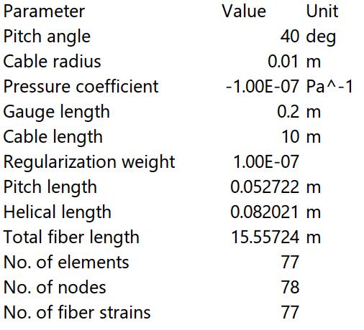
Parameter set #1
Input distribution of cable forces

Slide 9
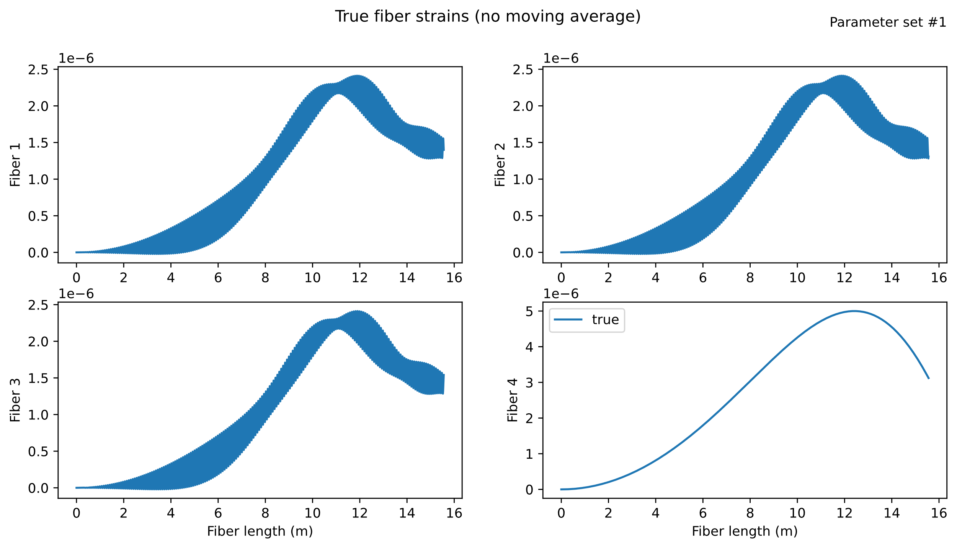

Slide 10
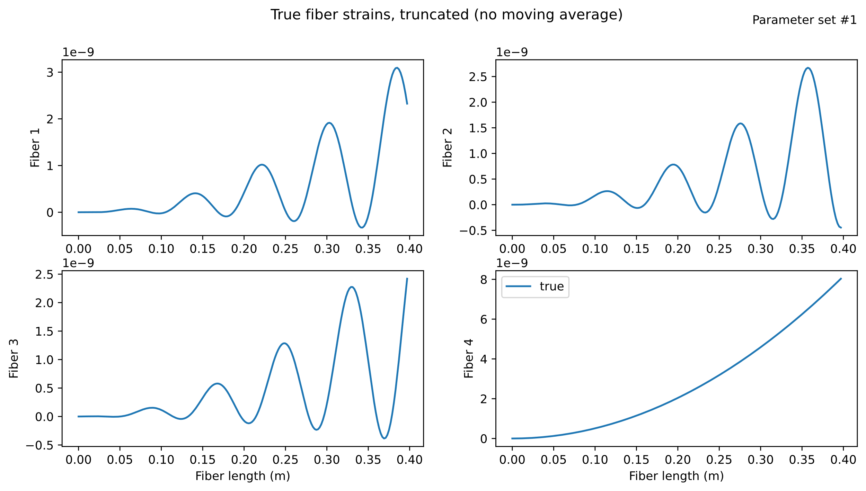

Slide 11
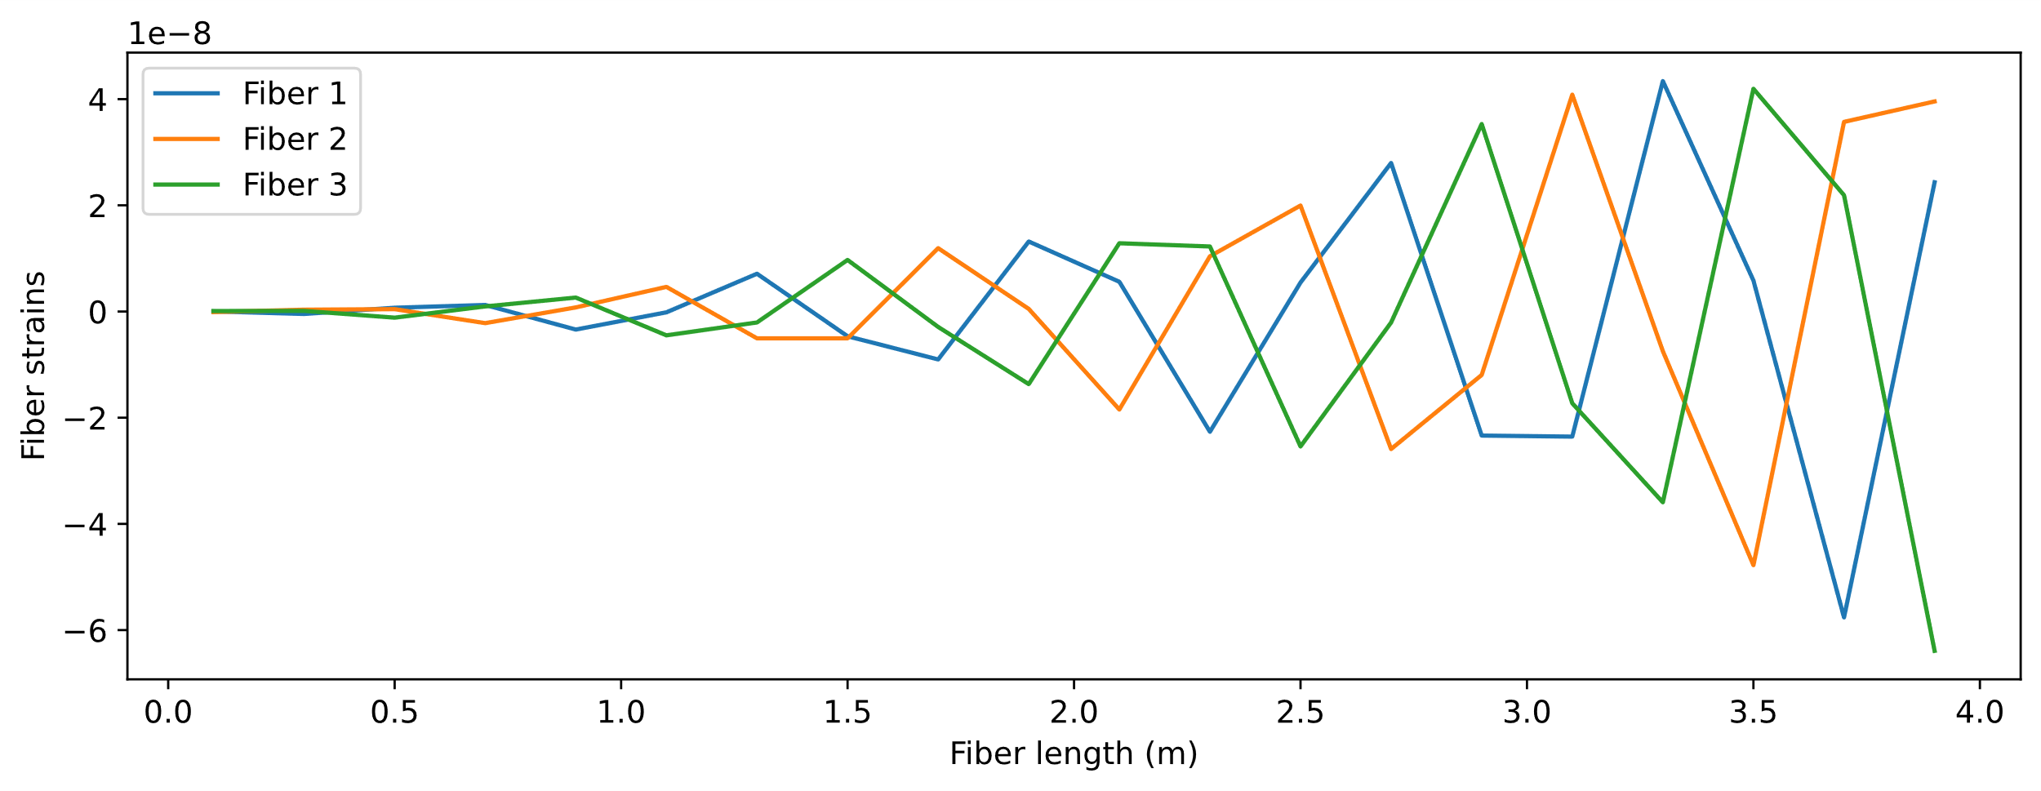
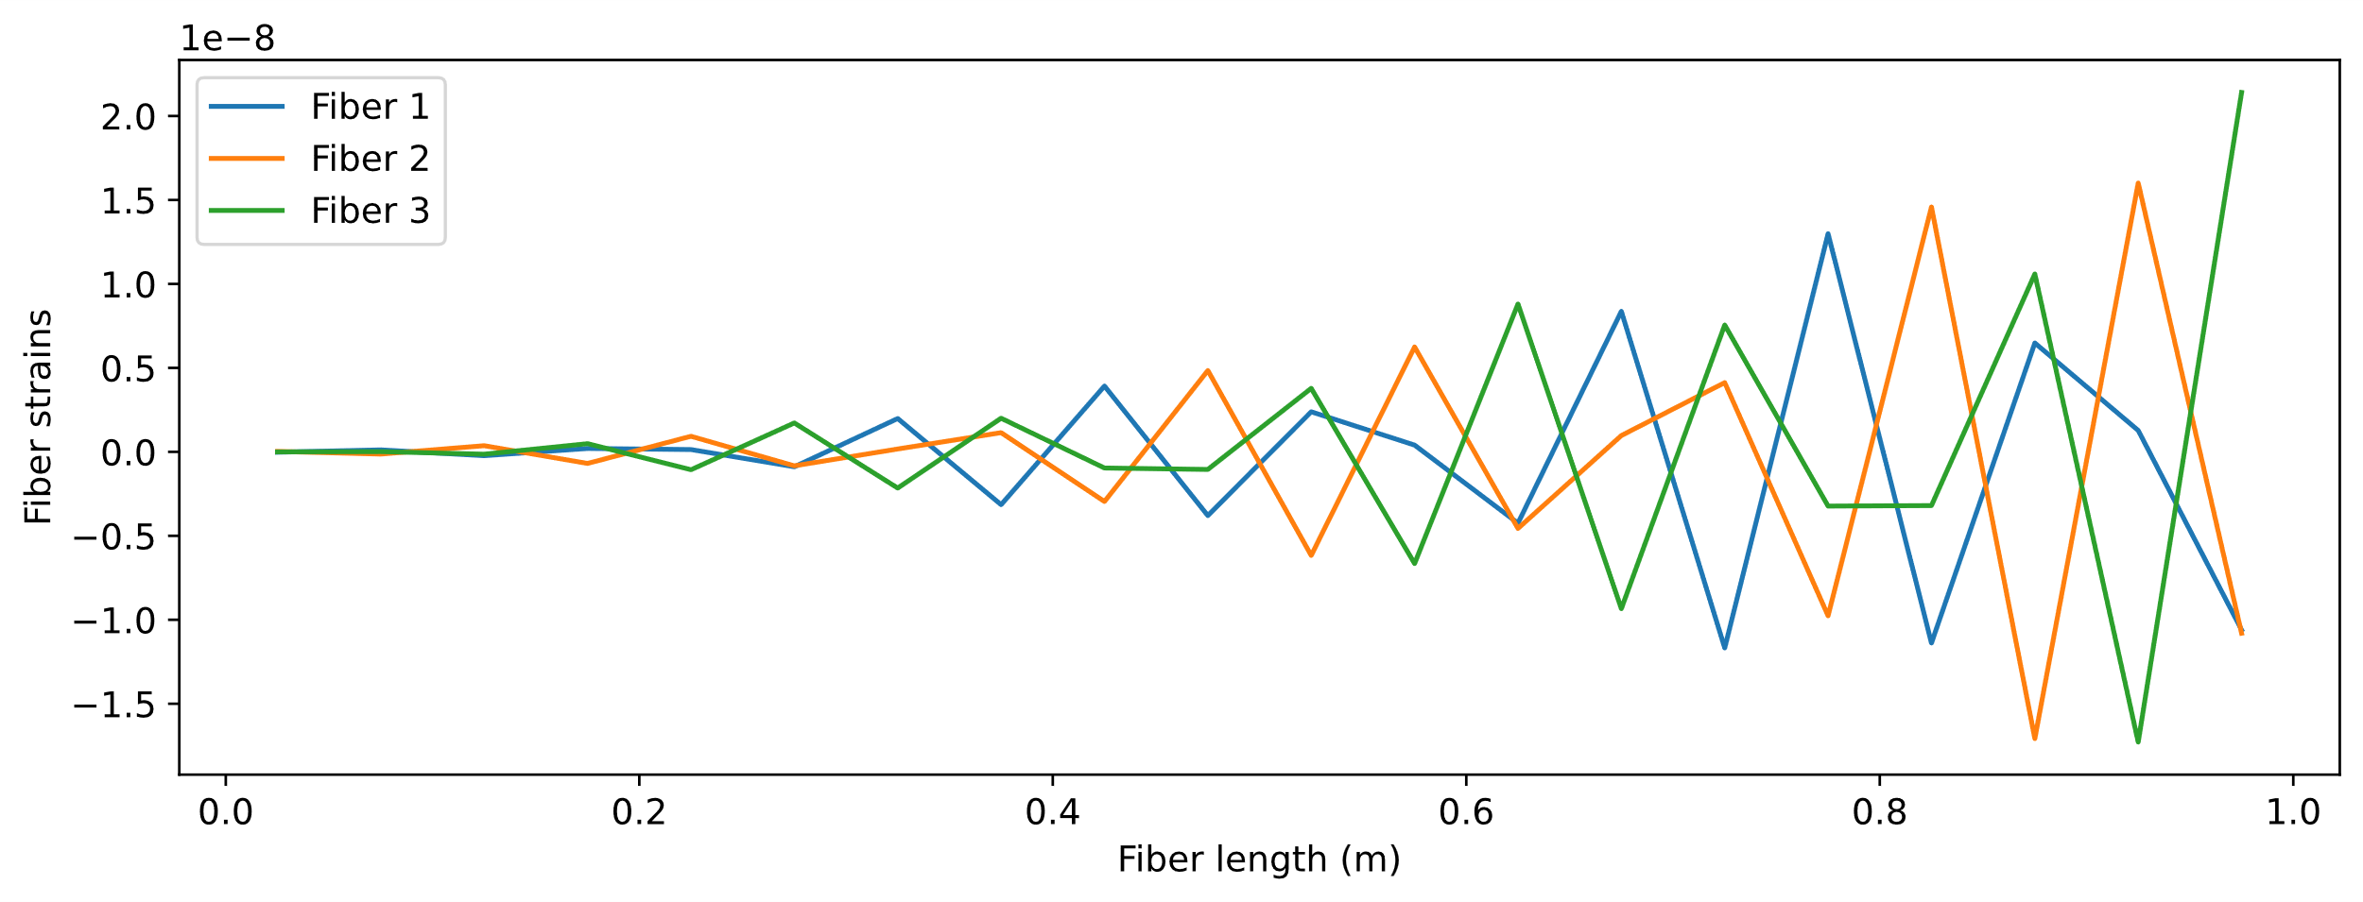
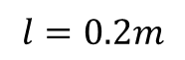
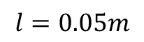
$$l=0.2m$$
$$l=0.05m$$

Slide 12
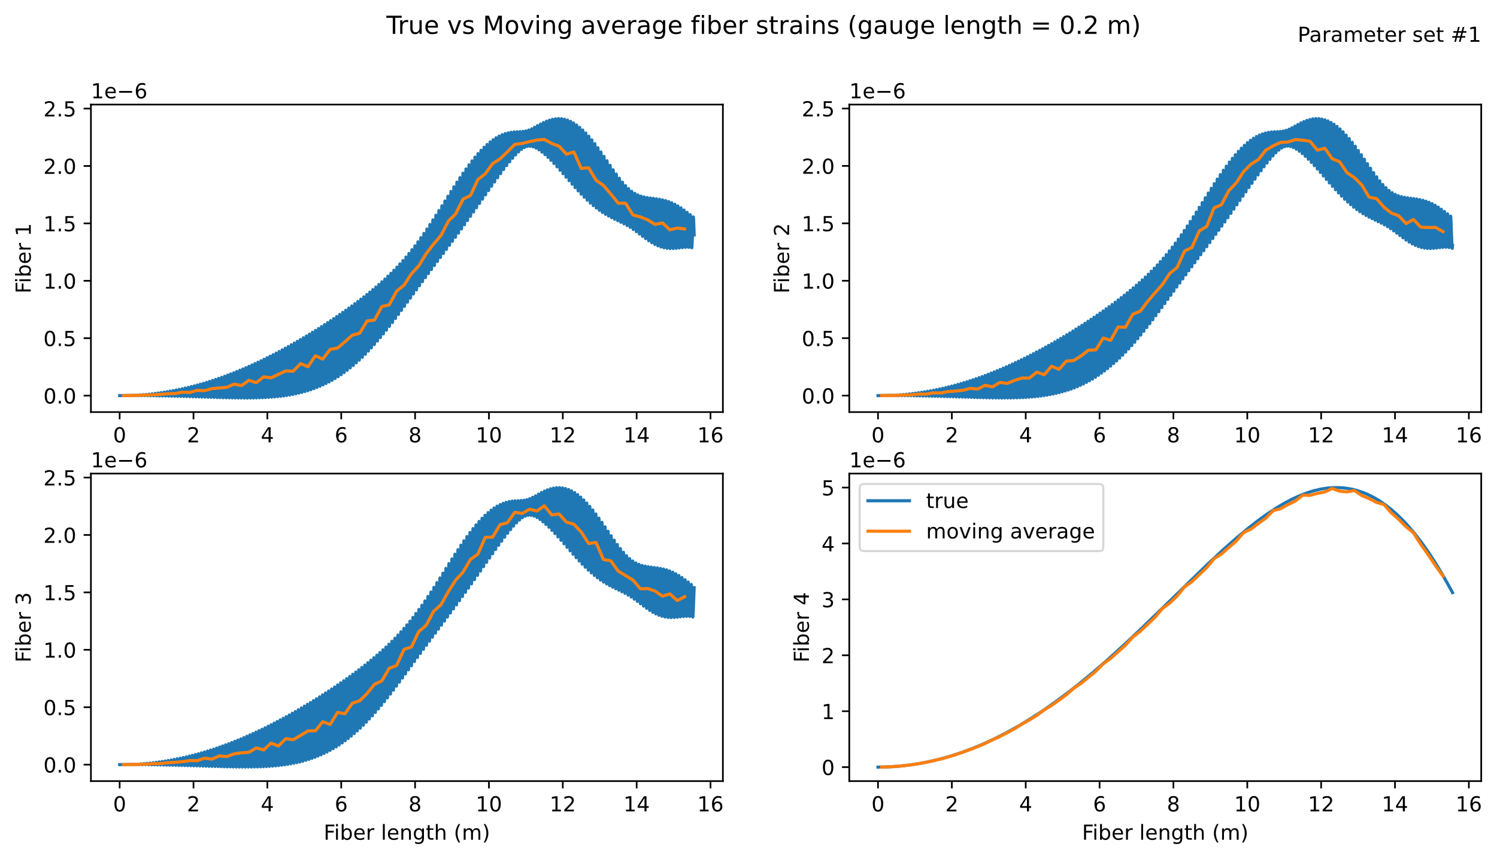

Slide 13
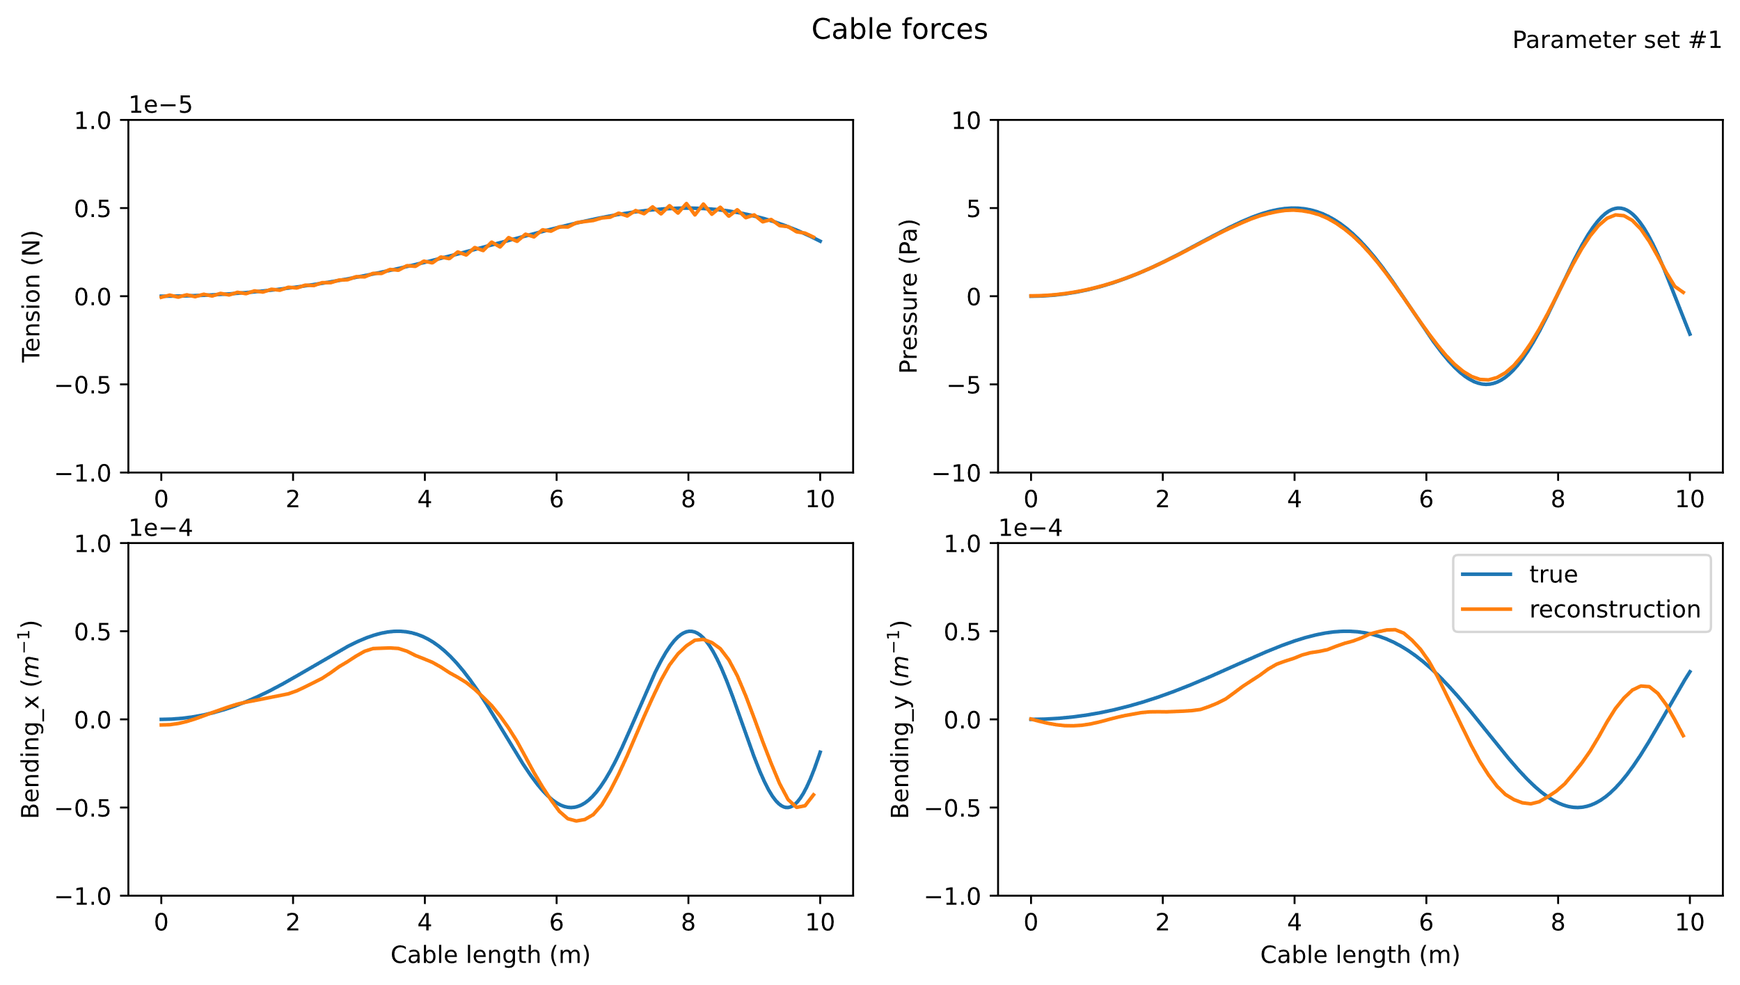

Slide 14
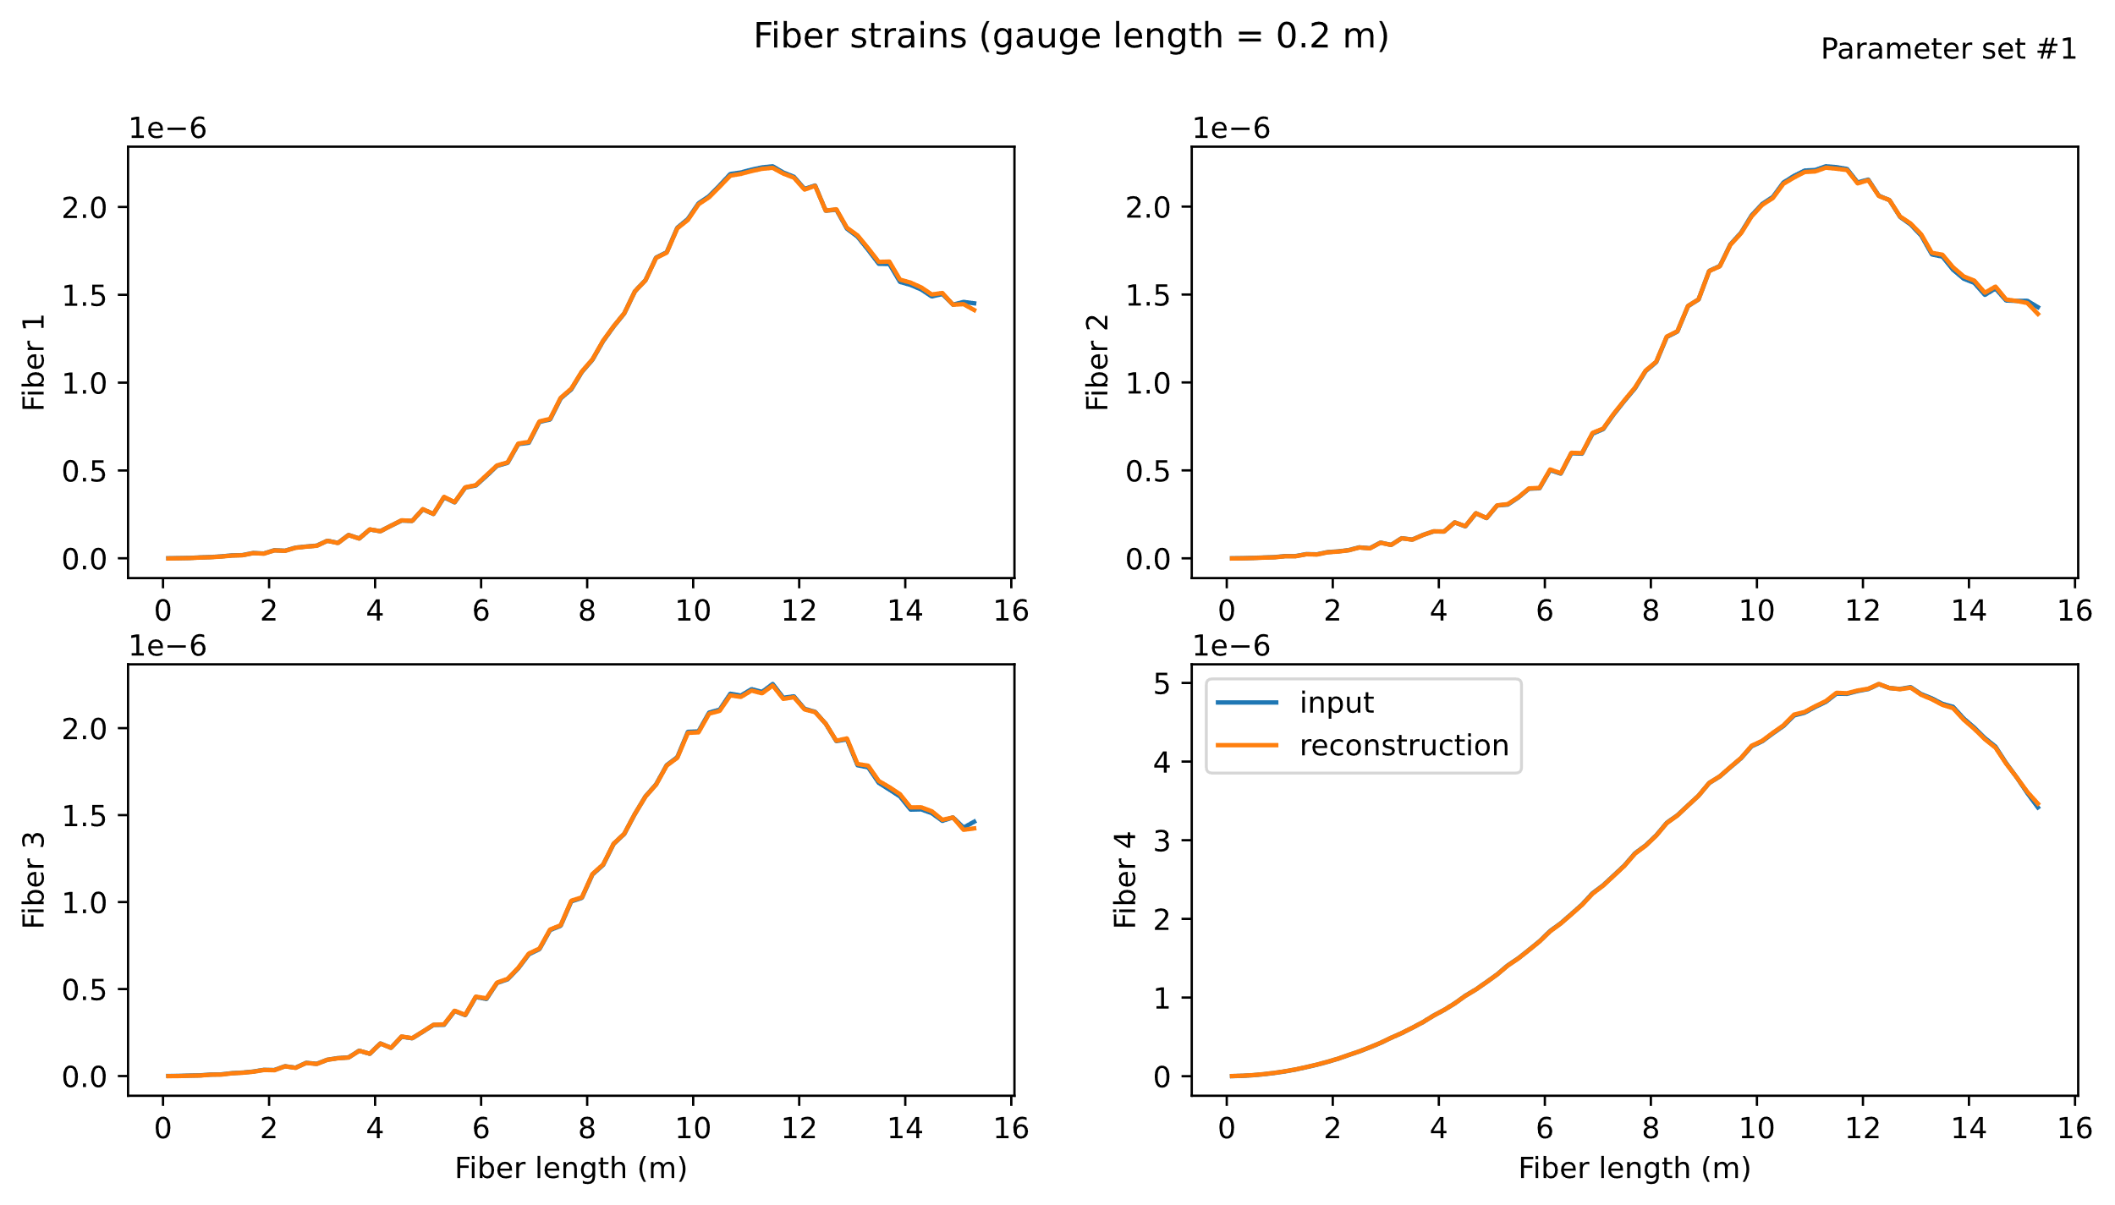

Slide 15
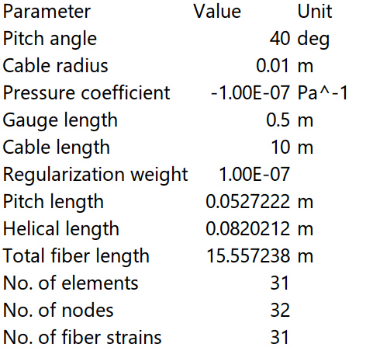
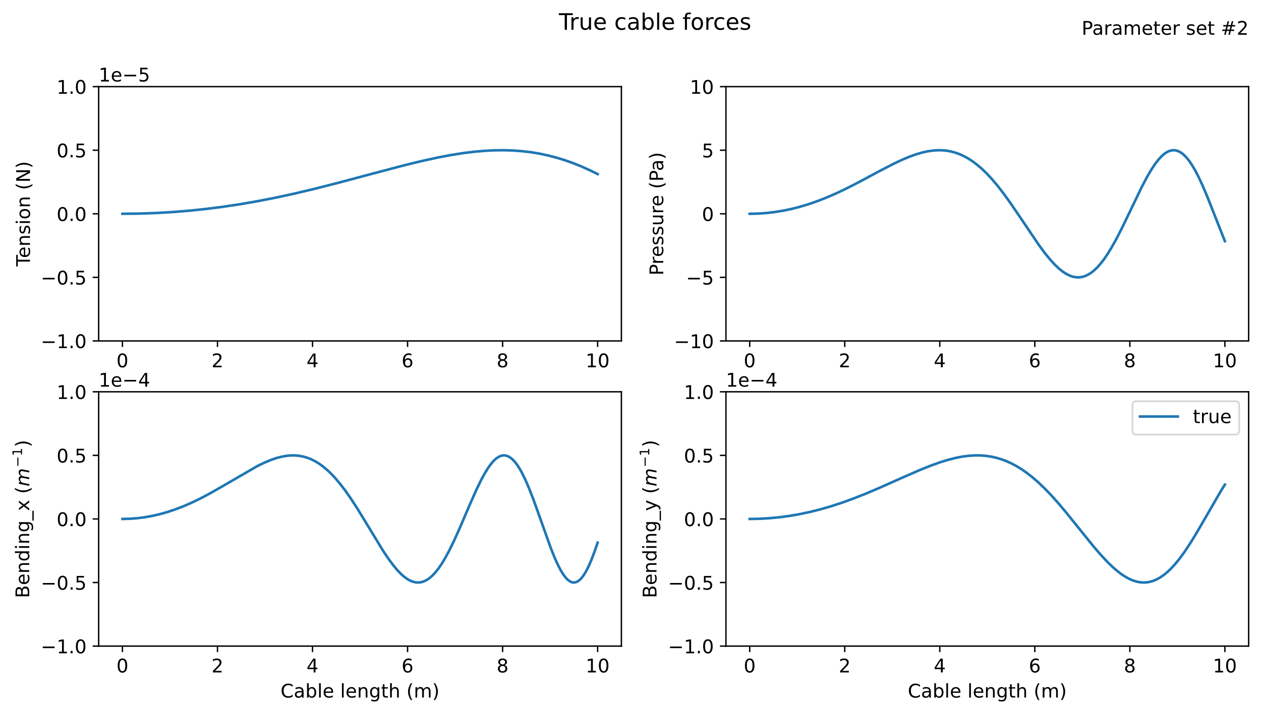
Parameter set #2
Input distribution of cable forces

Slide 16

Individual fiber strains

Slide 17
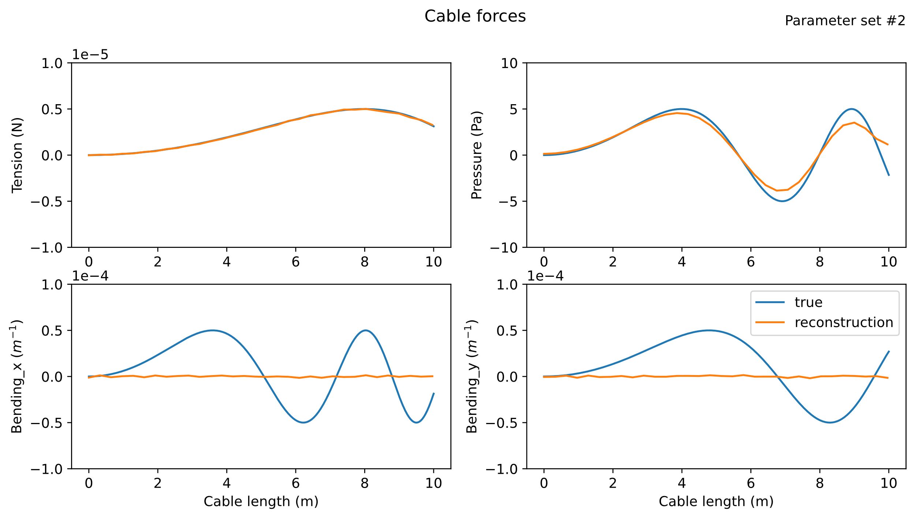
Result using four fibers

Slide 18
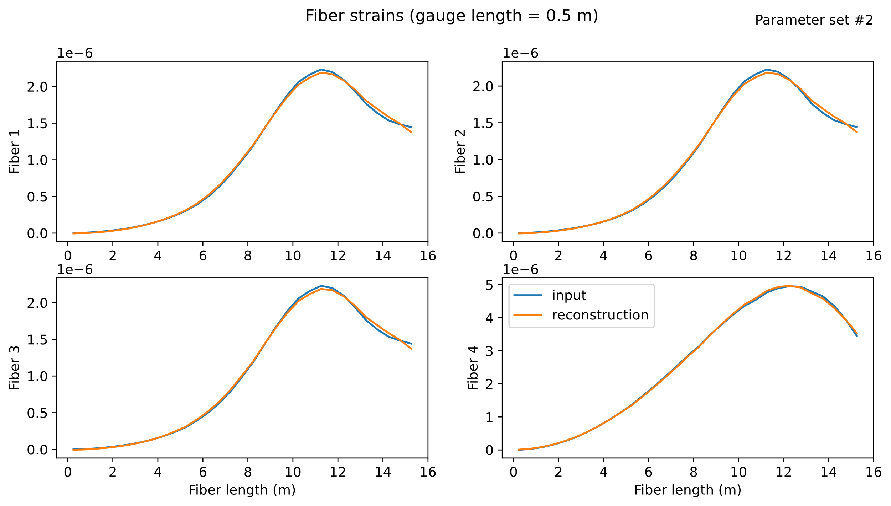

Slide 19
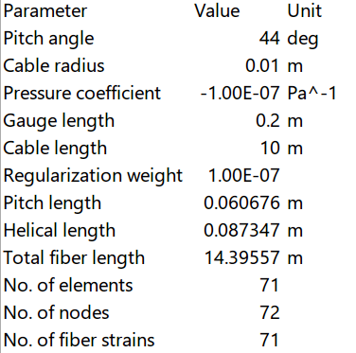
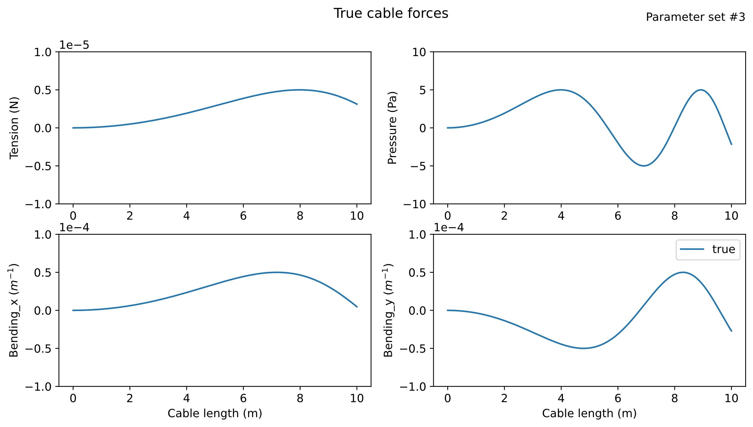
Parameter set #3

Slide 20
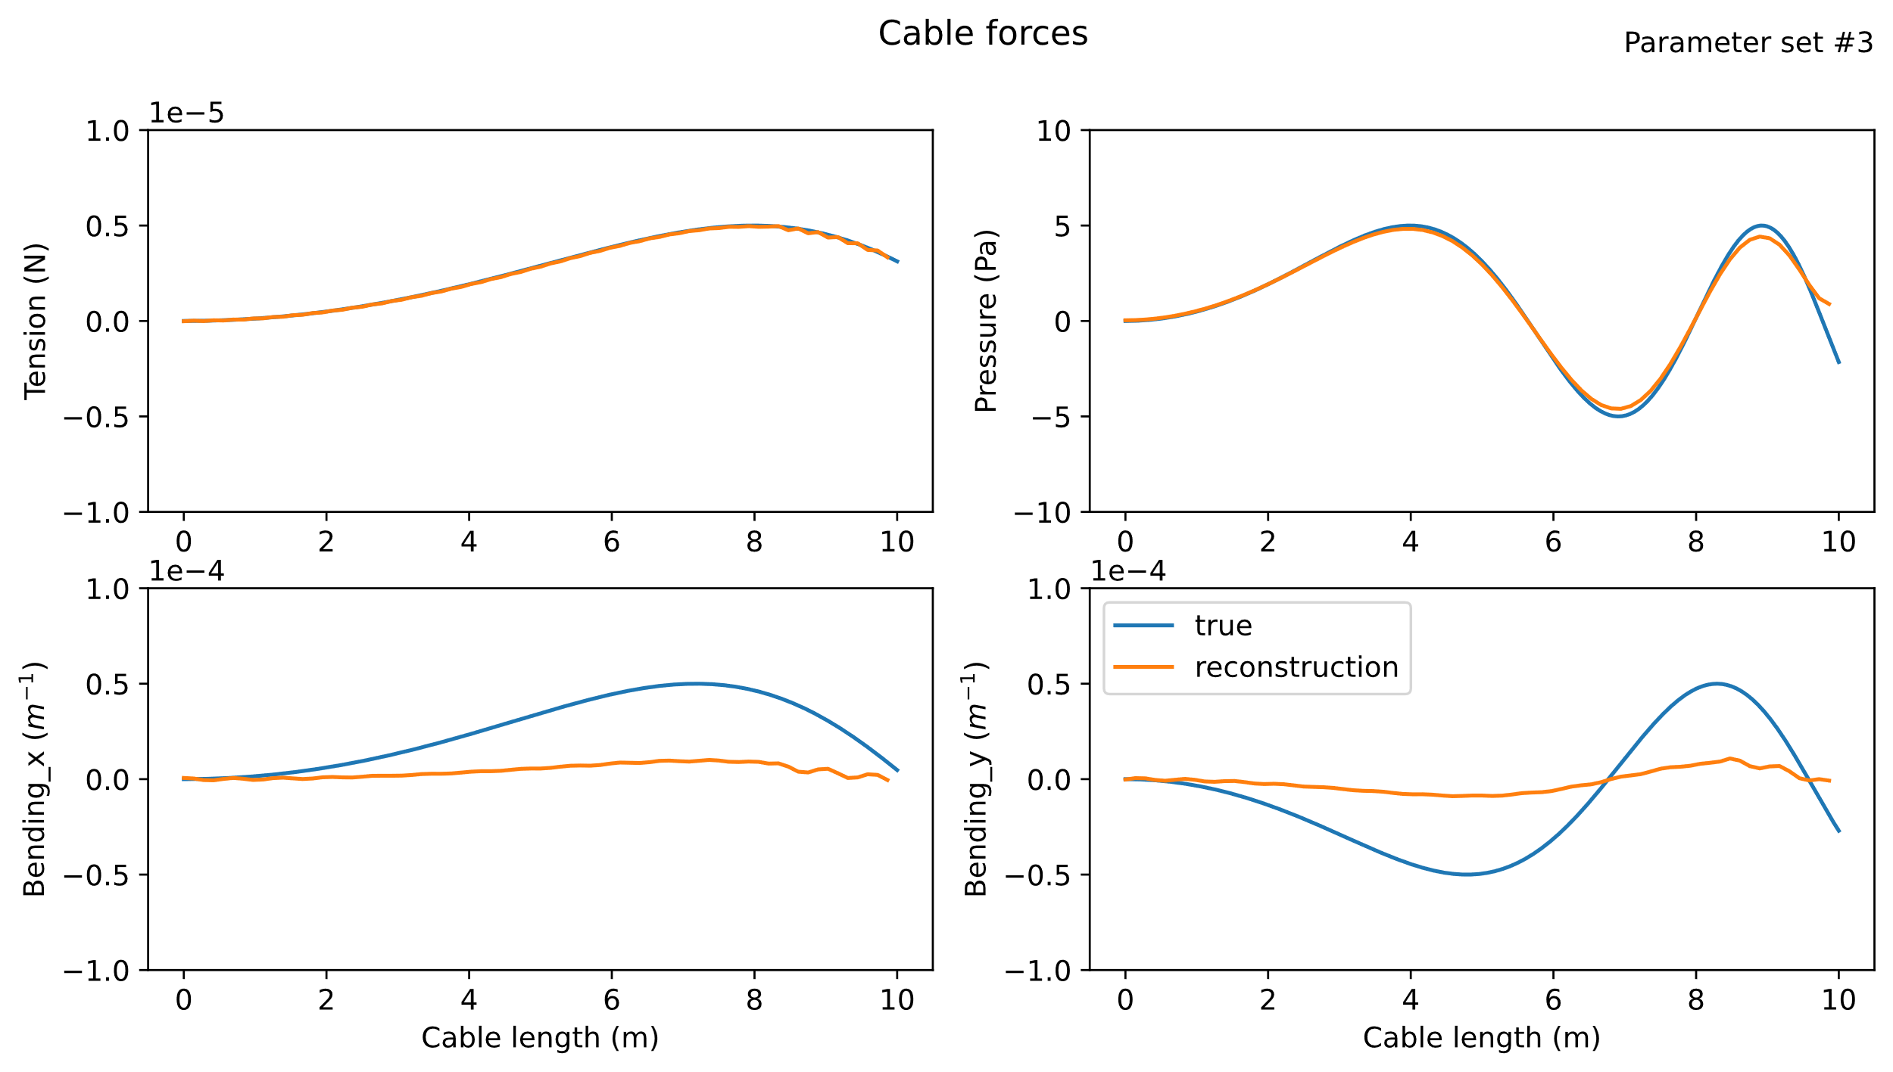

Slide 21
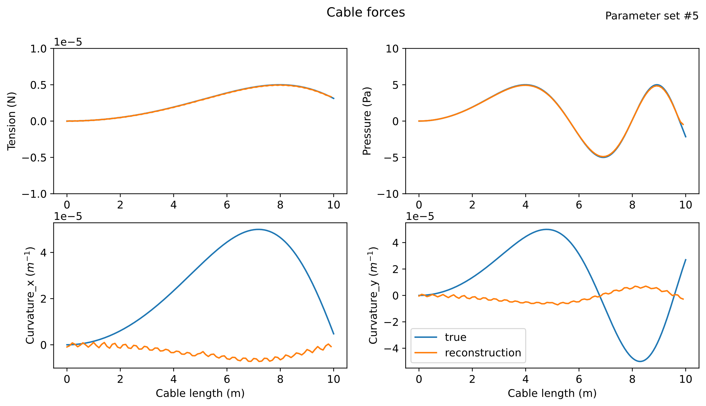
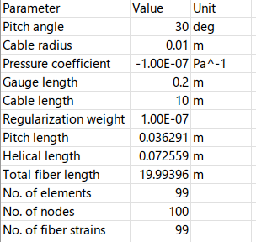

Slide 22
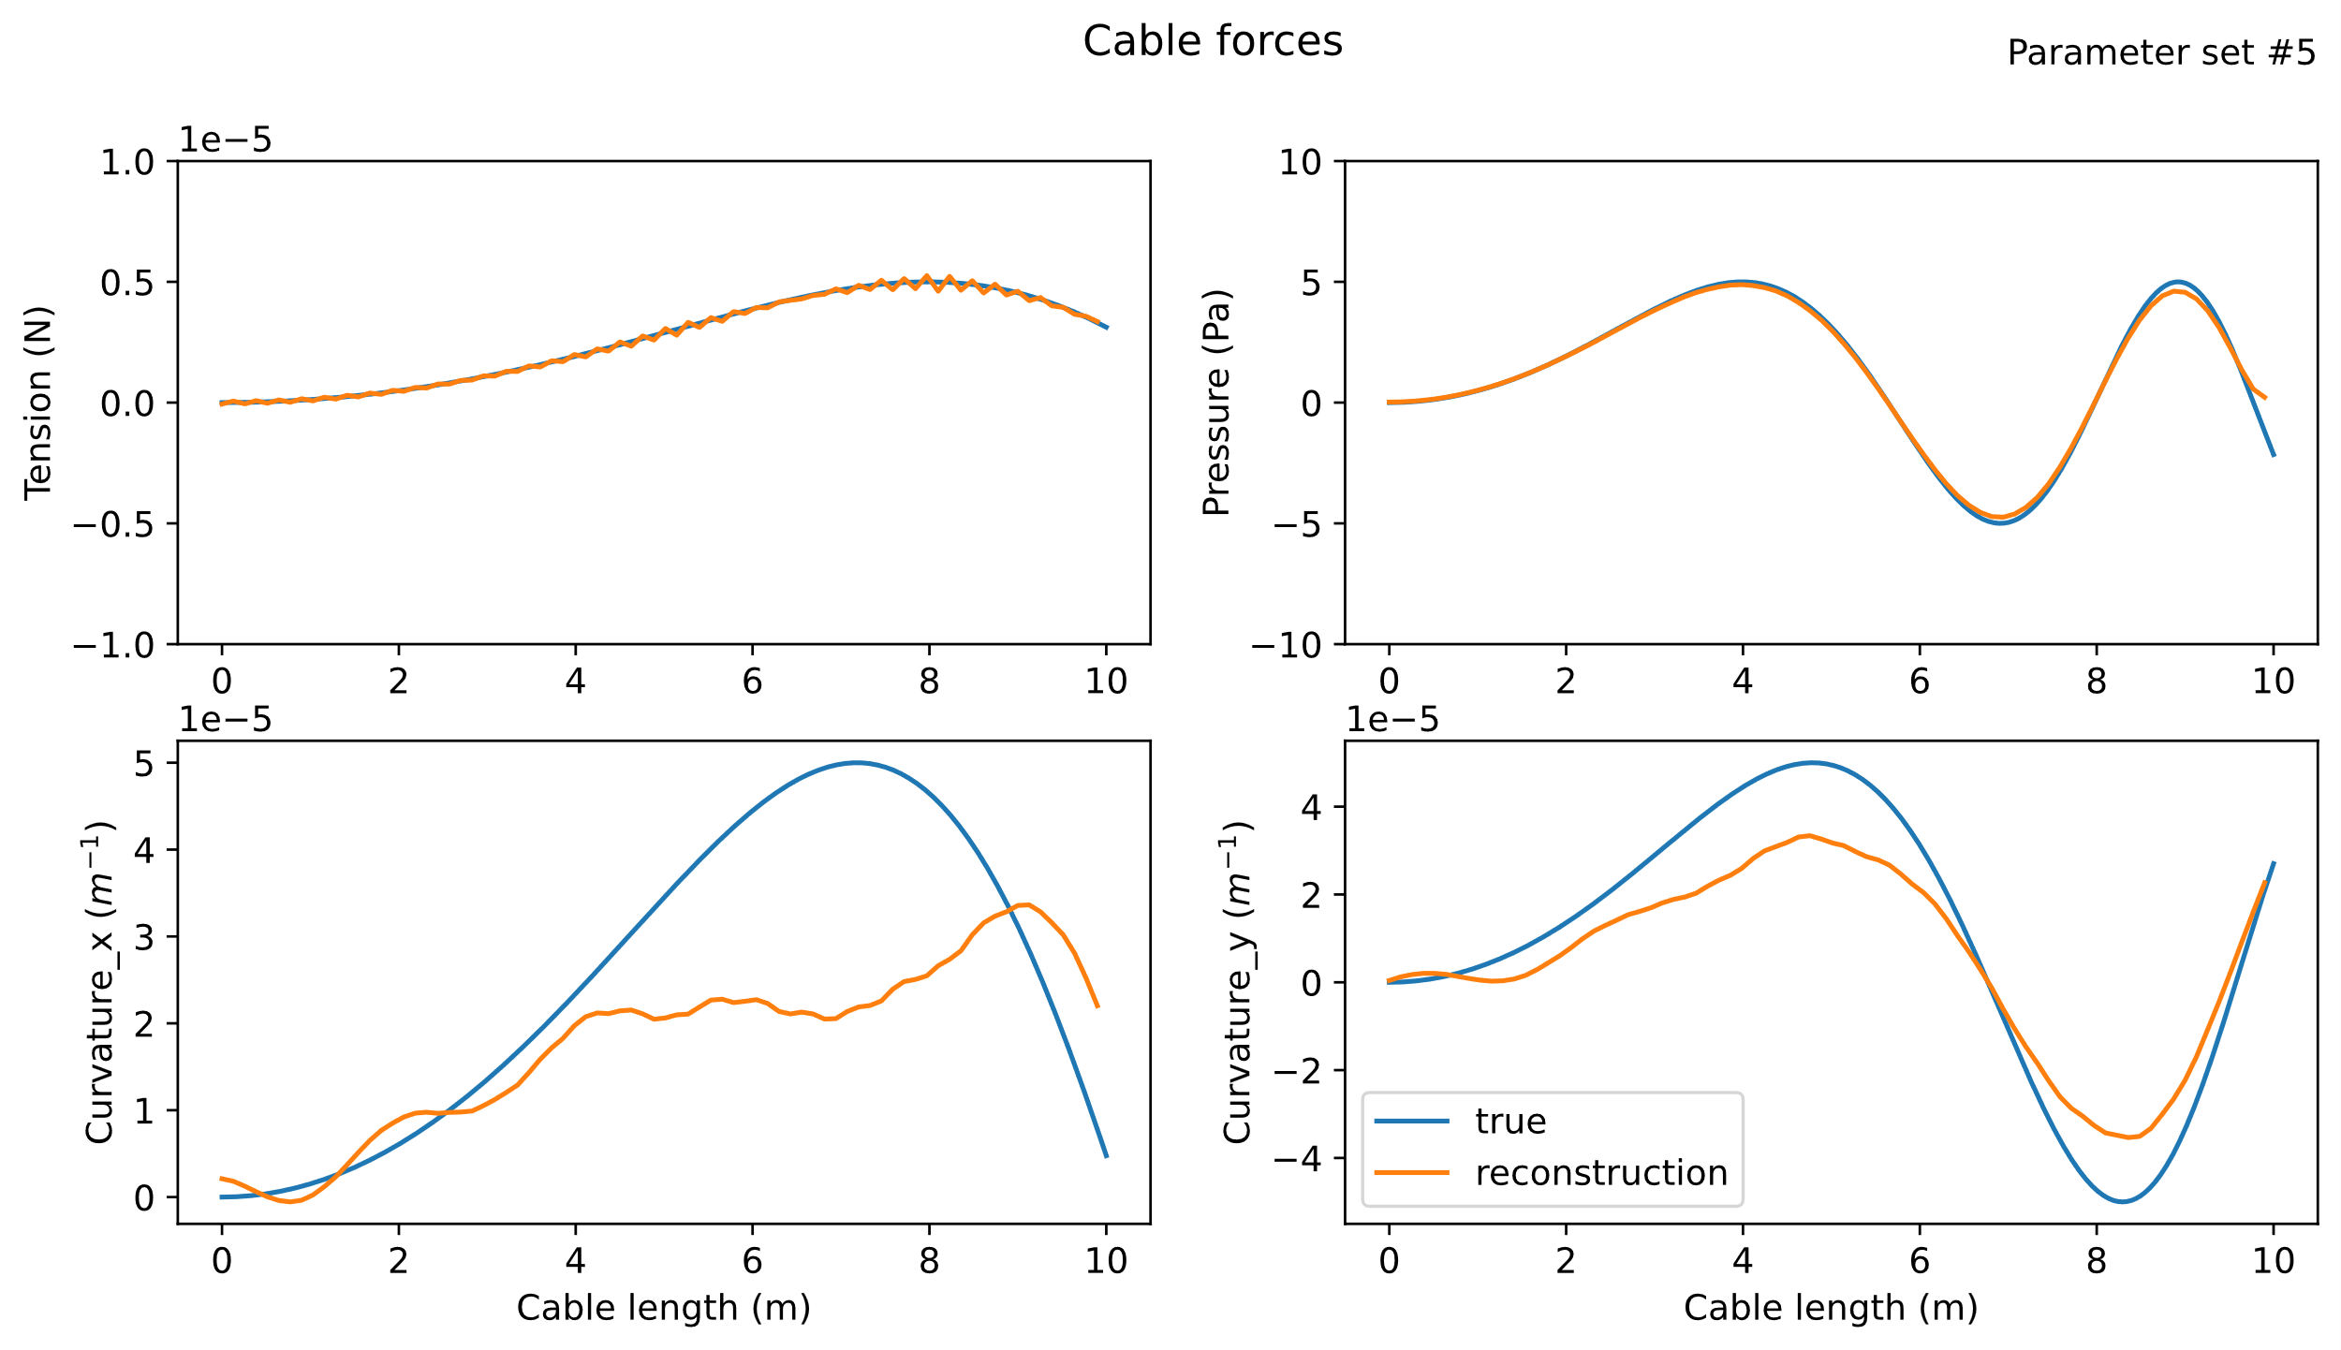
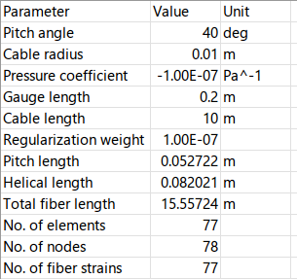

Slide 23
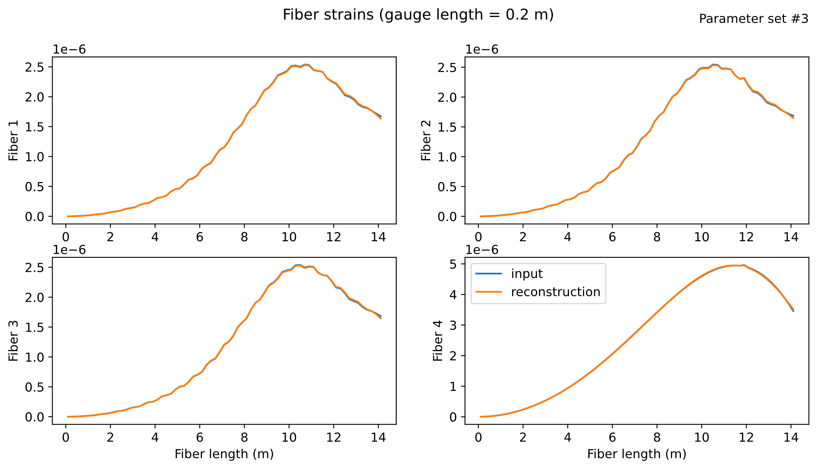

Slide 24
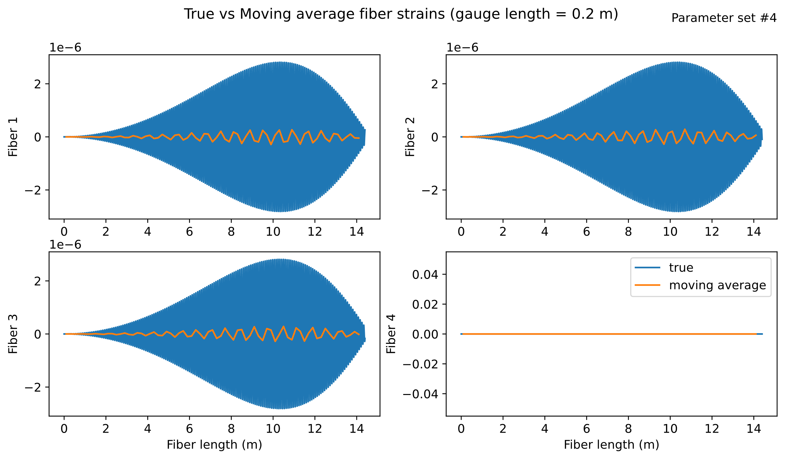
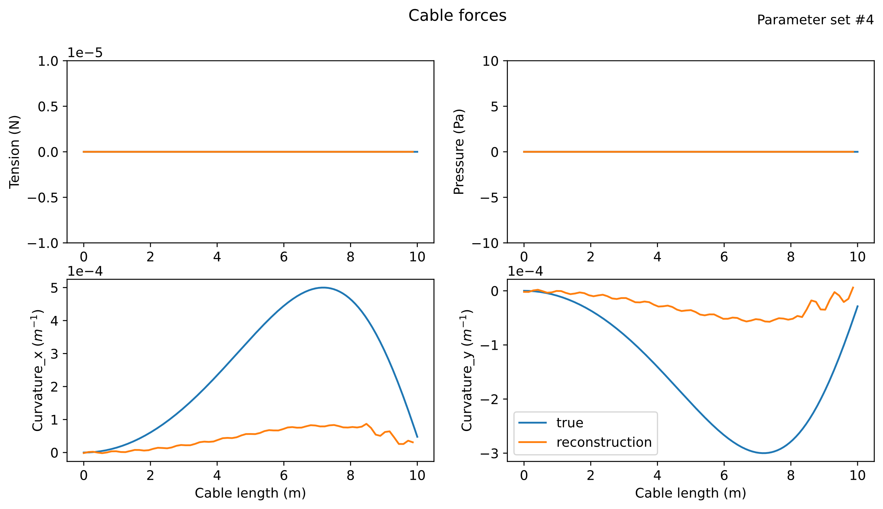
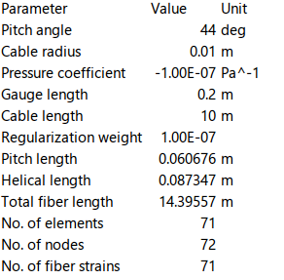


Slide 25
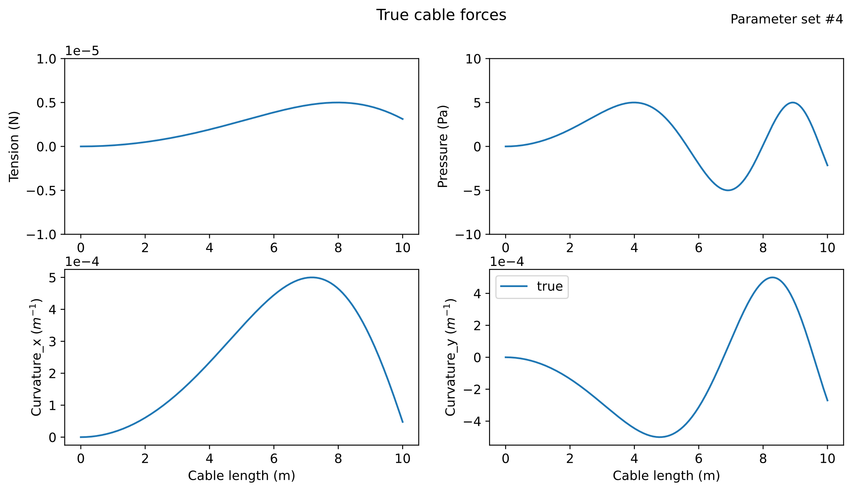
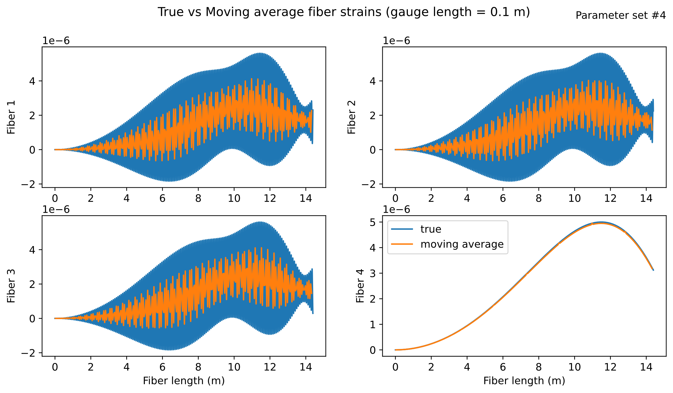



Slide 26








$$pitch=70$$
$$φ_{3}=220$$
$$φ_{1}=0,$$
$$φ_{2}=120,$$
$$φ_{3}=240$$
$$φ_{3}=220$$

Slide 27






$$φ_{1}=0,$$
$$φ_{2}=120,$$
$$φ_{3}=240$$
$$pitch=40$$
$$pitch=70$$

Slide 28






$$pitch=40$$
$$φ_{1}=0,$$
$$φ_{2}=120,$$
$$φ_{3}=240$$
$$φ_{1}=0,$$
$$φ_{2}=110,$$
$$φ_{3}=260$$

Slide 29



$$φ_{1}=0,$$
$$φ_{2}=120,$$
$$φ_{3}=240$$

Slide 30



Slide 31


SR = 20 mm

Slide 32


SR = 50 mm

Slide 33



Slide 34



Slide 35
Today’s notes:
1, Perpendicular pressure will not create axial strain.
2, Axial strain will affect pressure value from just helical FO
3, In the model, GL and SP need to be separated
4, For commercial application, position compensation among 4 fibers need to be added, to accept the data from IU.
5, SR above 0.5m, no hope to get bending, below 20cm, bending is possible
Do we need 4 FOs?
1 is enough or not?
2 is equivalent to 4 ?
What is best design for the helical angle?
Any hint for the merit to better SR in the future?

Slide 36



